Slide 1
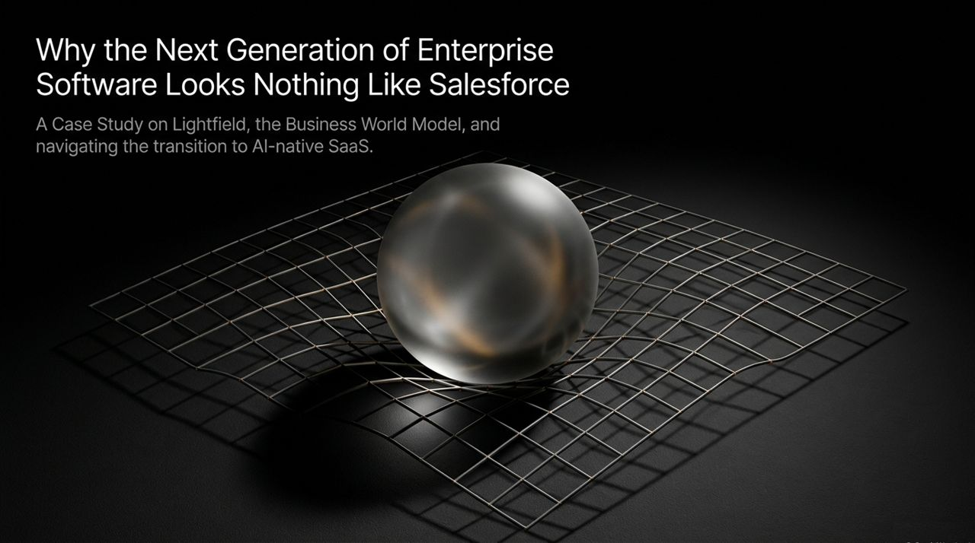
Notes:
Welcome, everyone. Today we’re diving into the future of enterprise software, taking a close look at Lightfield—a company redefining how business software functions.
For the past two decades, SaaS incumbents like Salesforce have dominated the enterprise by acting as static 'Systems of Record'. They are giant relational databases that require manual input from reps to track deals, contacts, and stages. But as artificial intelligence advances, this architectural model is showing its age.
Lightfield, which recently closed a $47M Series A led by Andreessen Horowitz, isn’t building another CRM with a chat widget slapped on top. Instead, they've pioneered a concept called the Business World Model. Built by a team with deep engineering roots at Facebook and Meta, Lightfield turns unstructured signals—emails, calls, Slack channels, and data warehouse metrics—into an active, high-fidelity model of customer reality. Over the next 15 slides, we’ll analyze how Lightfield navigated a high-profile pivot, disrupted traditional CRM architecture, invented a novel GTM strategy, and pioneered an AI-native pricing and organizational playbook.
https://www.youtube.com/watch?v=K5yGLO8c6T0

Slide 2
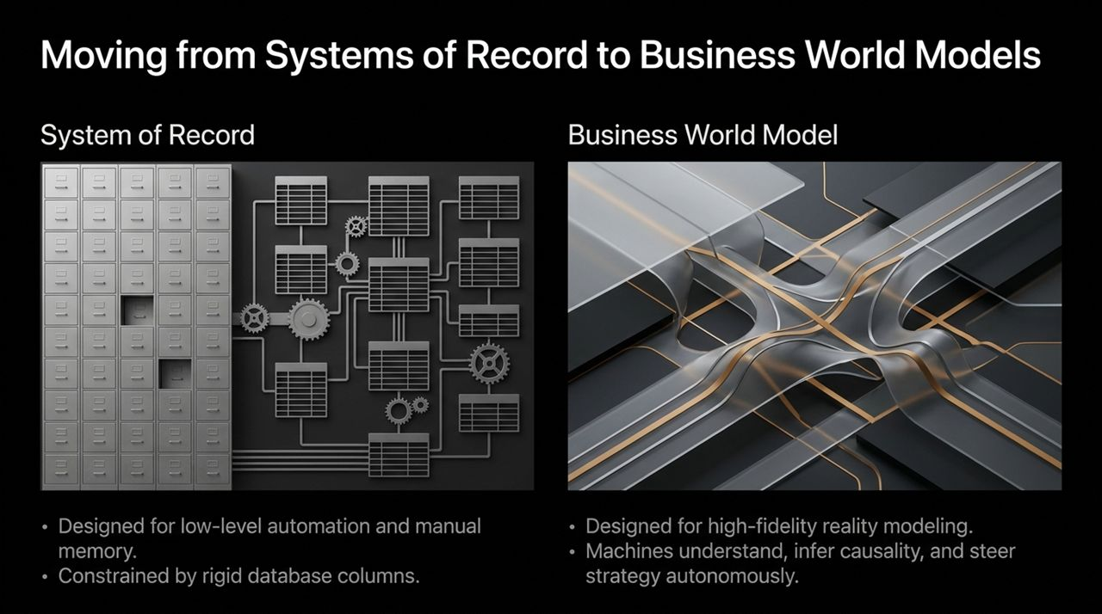
Notes:
To understand Lightfield, we must contrast two fundamentally different software philosophies. On the left, we have the traditional System of Record. These systems were designed around low-level manual memory and strict database schemas. Their primary utility is record-keeping—helping reps remember to make calls or providing leadership with static quarterly dashboards. The biggest flaw? They depend entirely on human compliance, which means the data is almost always stale or incomplete.
On the right is the Business World Model. Rather than forcing reality into rigid SQL columns, a World Model dynamically captures every interaction across all touchpoints. AI agents can continuously infer causality, automatically update underlying metrics, and run scenario planning. Instead of asking reps to log calls, the system passively absorbs all activity and constructs an accurate mirror of customer reality. This shifts software from a reactive database into an active partner that helps steer business strategy.

Slide 3
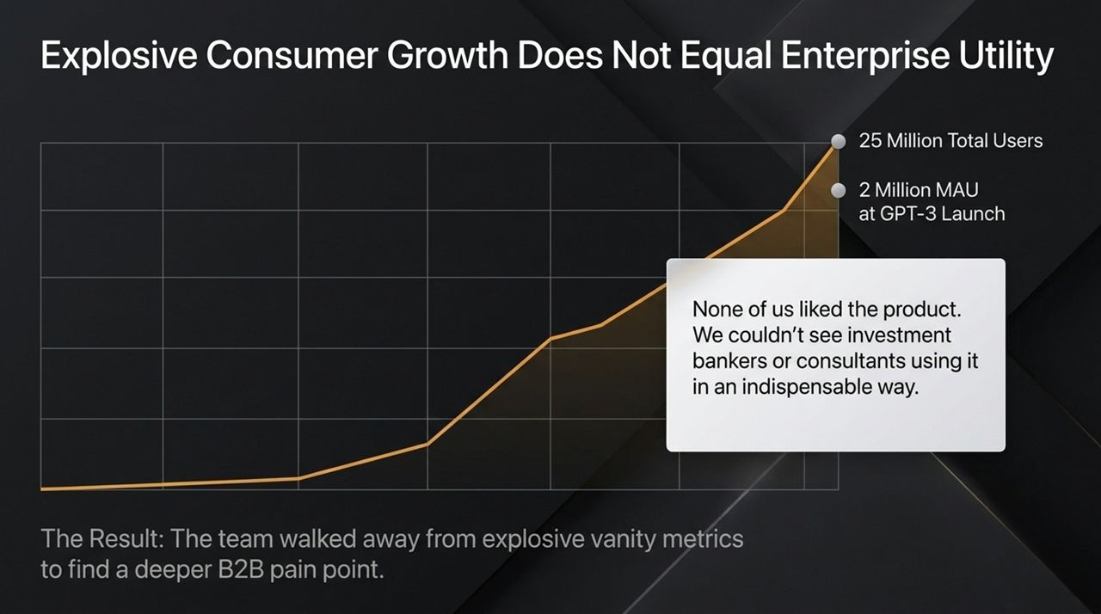
Notes:
Lightfield’s founding story is one of the most remarkable pivots in recent tech history. The team originally launched Tome, an AI-powered presentation platform. When GPT-3 dropped, Tome experienced viral, explosive consumer growth. They hit 25 million total users and 2 million monthly active users almost overnight.
Yet, despite these hyper-growth vanity metrics, the team realized something uncomfortable: they didn't like their own product. They observed that while students and casual users loved generating AI slides, high-end professionals—investment bankers, management consultants, executives—could not use it in an indispensable way. The AI models at the time lacked the necessary customer context to draft deep, meaningful business narratives.
Rather than riding out vanity metrics or waiting years for base models to improve, Keith and his team walked away from millions of users to find a deeper enterprise pain point.

Slide 4
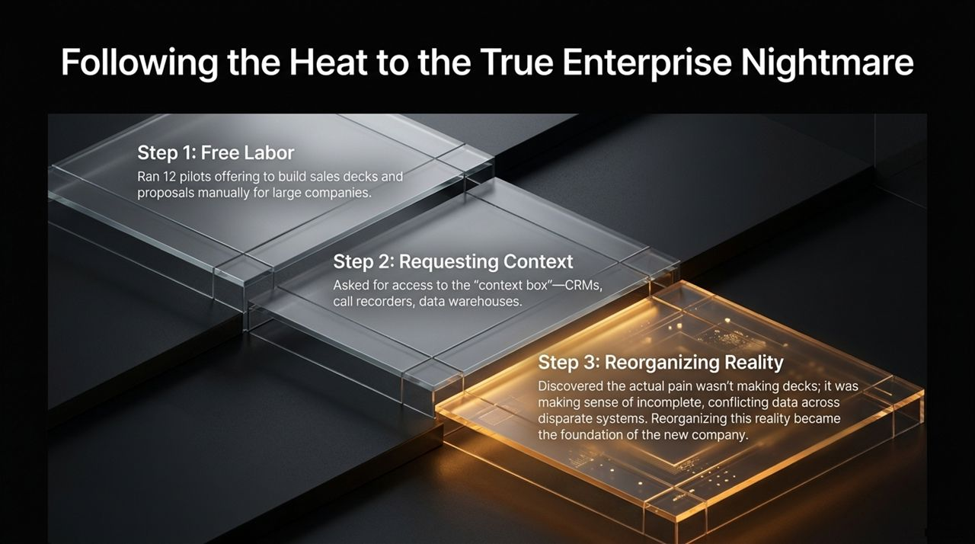
Notes:
How do you transition from a viral B2C AI product to a foundational B2B platform? By systematically 'following the heat'.
Step 1: The team combed through Tome’s user data, identified B2B sales and marketing power users, and offered 12 large enterprises a deal: 'We will manually build your sales decks and proposals for free.'
Step 2: To draft these proposals, they asked clients for access to their 'context box'—Salesforce, Gong call recordings, Slack, and Snowflake data warehouses.
Step 3: During this process, they had an epiphany. The hardest part of generating a proposal wasn't creating the slides; it was resolving conflicting and incomplete customer context spread across disconnected systems. Call recordings contradicted CRM pipeline stages, and product usage data was disconnected from customer support logs. Reorganizing this chaotic reality emerged as the true enterprise nightmare worth solving.

Slide 5
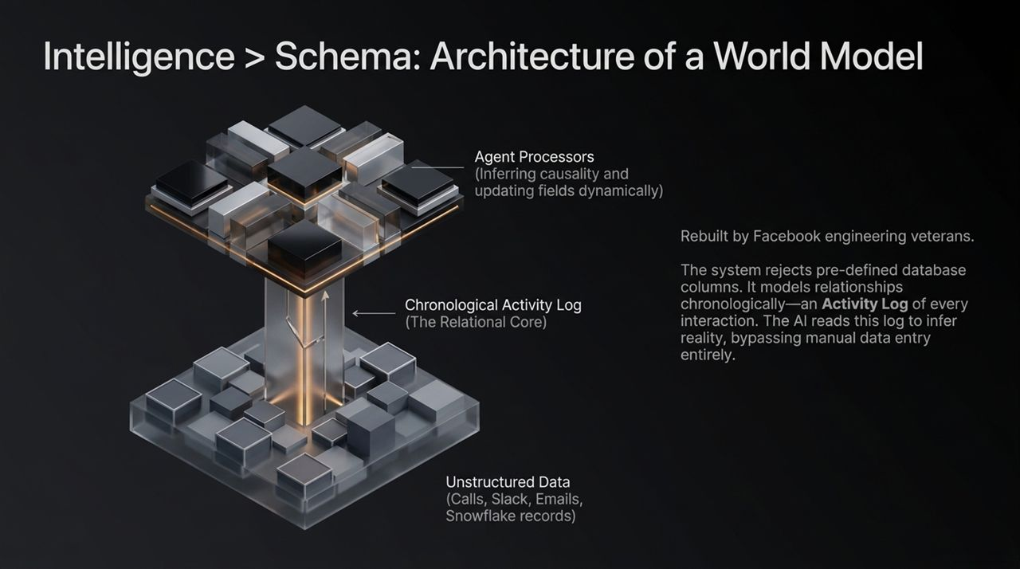
Notes:
Here we look under the hood of Lightfield's architectural breakthroughs. Traditional software relies on predefined database columns (SQL schemas). When a deal progresses, someone has to change a field in a table.
Lightfield completely rejects this pre-defined relational approach. Drawing from their experience building the Facebook News Feed and Timeline, the engineers built a Chronological Activity Log as the core data layer. Every call, email, Slack message, ticket, and data warehouse event is recorded sequentially along a timeline.
On top of this log sit Agent Processors. Instead of requiring human input, AI agents process this stream of unstructured context to infer causality and dynamically populate fields. Intelligence completely replaces pre-configured schema.

Slide 6
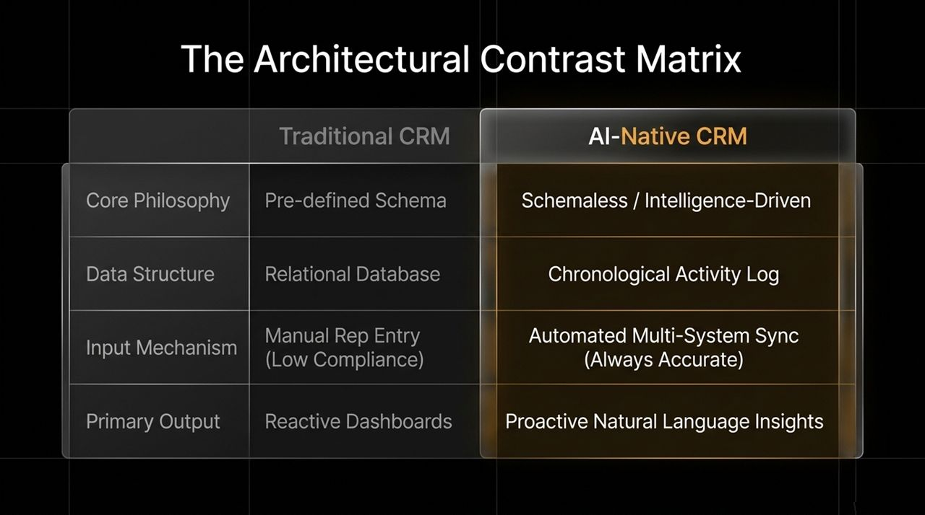
Notes:
To synthesize this architectural shift, let’s review the Contrast Matrix:
Core Philosophy: Legacy CRMs are forced onto pre-defined, rigid schemas. Lightfield is schemaless and driven by ambient intelligence.
Data Structure: Relational SQL tables versus a unified Chronological Activity Log.
Input Mechanism: Manual rep data entry—which suffers from low compliance—versus automated multi-system background sync.
Primary Output: Reactive, historical dashboards versus proactive, natural-language operational insights.

Slide 7
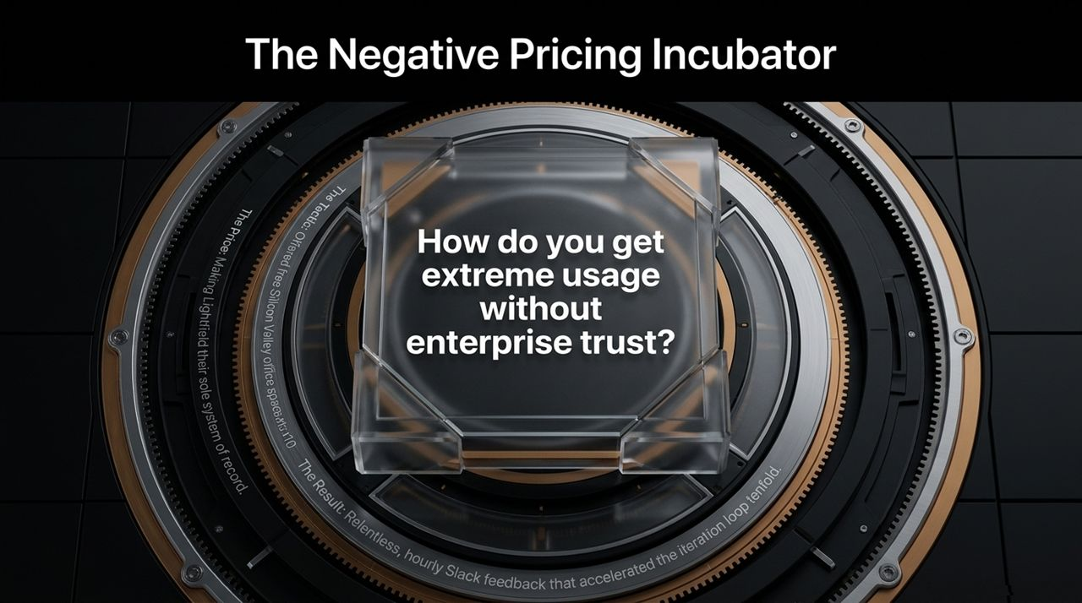
Notes:
Once Lightfield built their v1 prototype, they faced a classical paradox: How do you get startups and enterprises to trust a 4-month-old CRM with their core data?
The team turned an operational liability into a distribution engine. They had an expensive, unused San Francisco office lease leftover from Tome. Keith posted on X and LinkedIn offering free desk space to early-stage startups—on one condition: they had to use Lightfield as their sole system of record.
This 'Negative Pricing' strategy brought 10 startups into their building. Founding teams used the product daily, giving hourly feedback over Slack whenever features broke or lagged. This intense feedback loop accelerated product maturity.

Slide 8
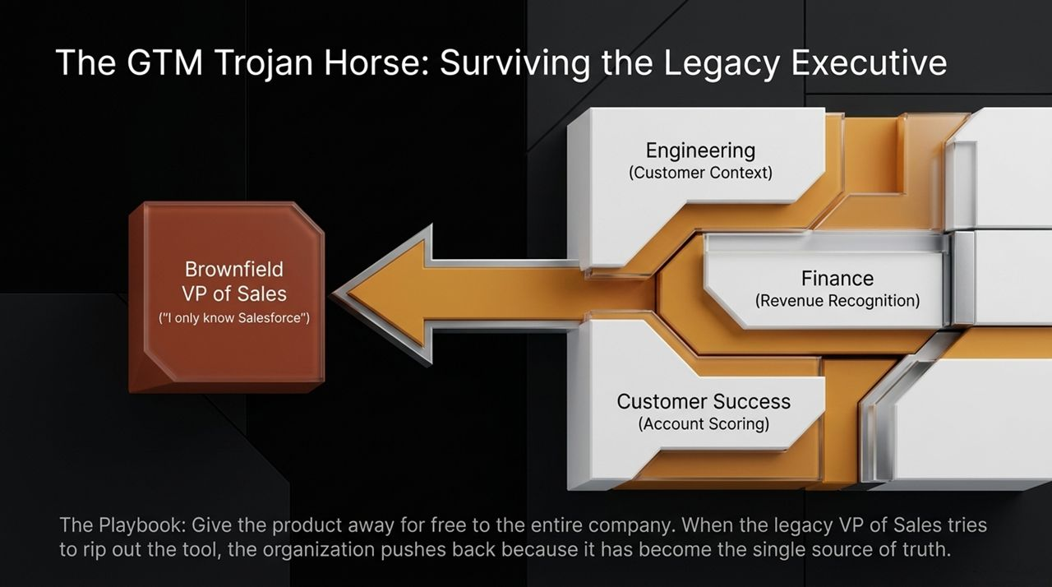
Notes:
As Lightfield’s customer startups grew from 5 to 100+ reps, they hit a classic enterprise GTM hurdle: the arrival of a veteran VP of Sales who insists, 'I only know Salesforce.'
To survive the legacy sales leader, Lightfield designed a GTM Trojan Horse playbook:
Give seats away for free across non-sales departments (Engineering, Finance, CS).
Engineering uses Lightfield to track customer feature requests; Finance uses it for revenue recognition; Customer Success uses it for health scoring.
When a new VP of Sales tries to rip out Lightfield to install Salesforce, the entire company pushes back because Lightfield has become the cross-functional source of truth.

Slide 9
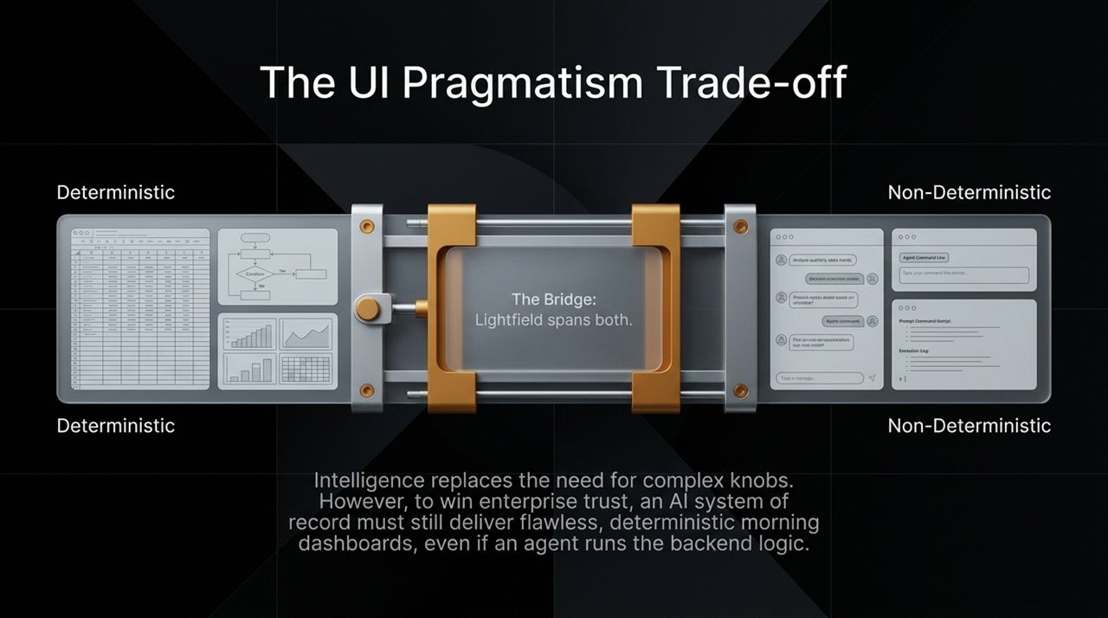
Notes:
AI product design often swings between extremes: complex control panels with thousands of knobs or radical minimalist chat interfaces. Lightfield adopted a pragmatic middle ground. While natural language and agents handle background workflows, executive users still want deterministic, predictable daily dashboards. Sales leaders want to view revenue graphs and spreadsheet tables over morning coffee without worrying about probabilistic LLM outputs. Lightfield bridges both worlds: standard deterministic UI surfaces on the front end, backed by dynamic AI agent logic in the core architecture.

Slide 10
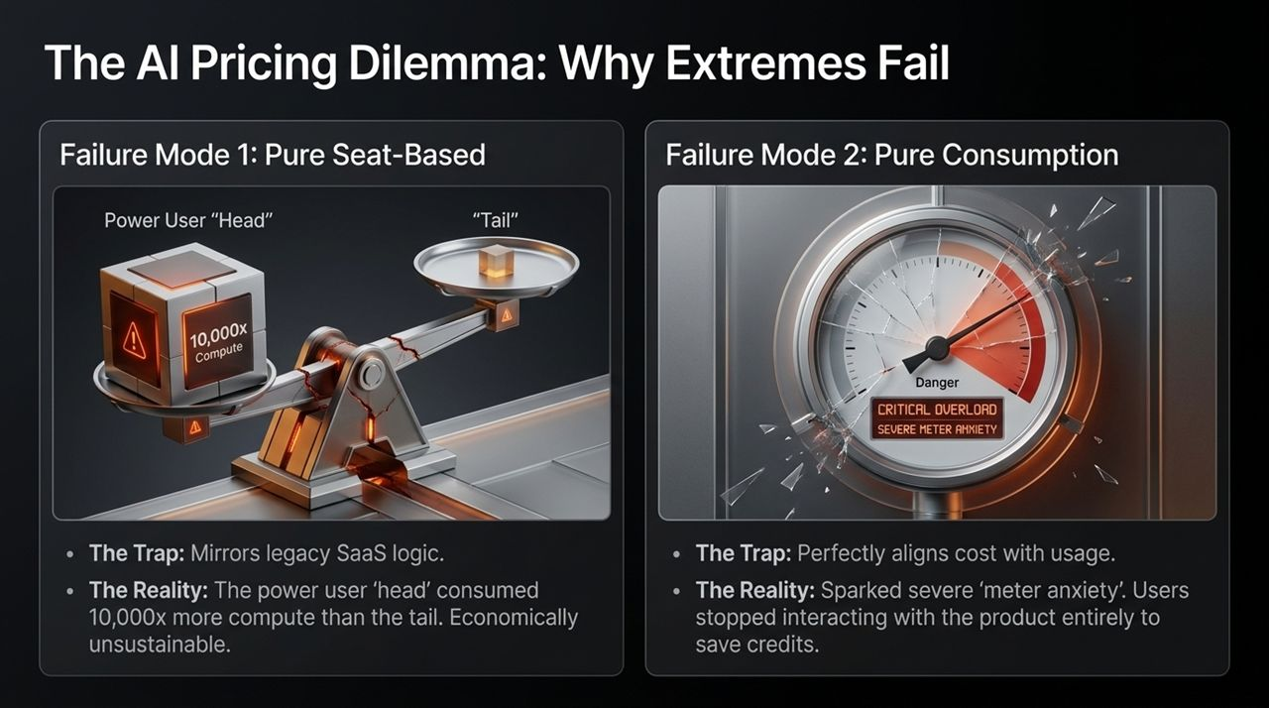
Notes:
Pricing AI software is one of the toughest challenges in SaaS today. Lightfield tested both industry extremes and saw both fail: Failure Mode 1 (Pure Seat-Based): Mirroring traditional SaaS per-seat pricing caused massive margin erosion. Power users ('the head') consumed 10,000x more compute than passive users ('the tail'), making flat per-seat economics unsustainable. Failure Mode 2 (Pure Consumption): Switching strictly to credits/token usage eliminated margin risk but induced meter anxiety. Users stopped using the product out of fear of running up bills.

Slide 11
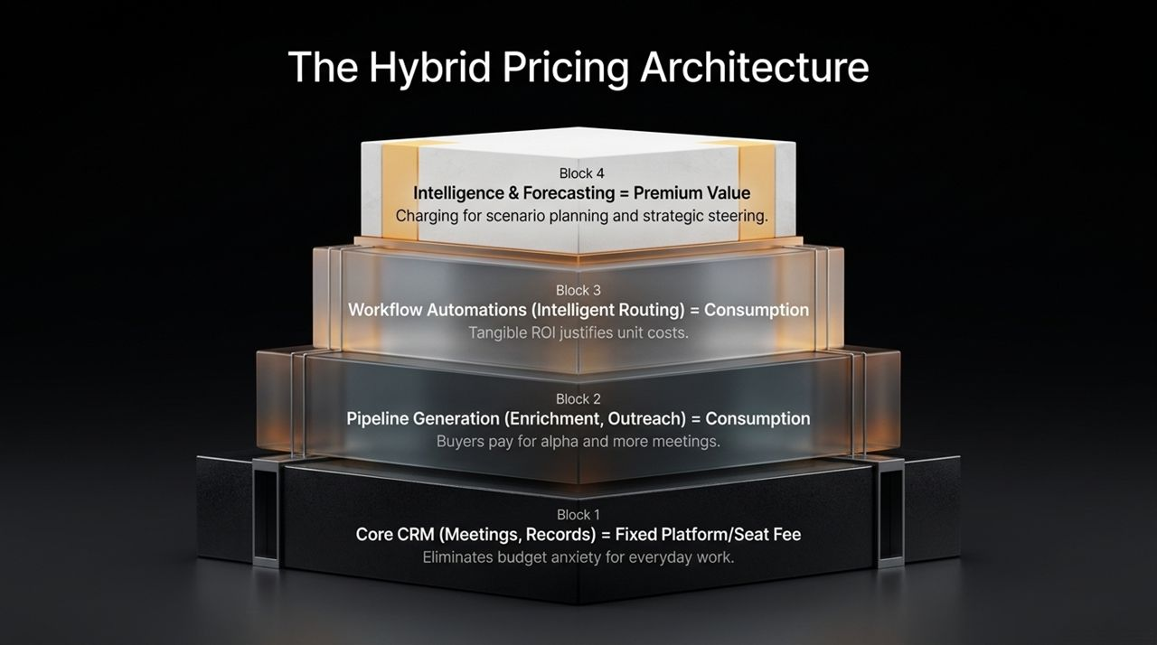
Notes:
To resolve the pricing dilemma, Lightfield pioneered a 4-Block Hybrid Pricing Architecture:
Block 1: Core CRM (Platform / Seat Fee): Baseline meeting capture and record updates are billed via flat seat fees to eliminate budget anxiety.
Block 2: Pipeline Generation (Consumption): Lead enrichment and automated outreach are billed on usage, where direct ROI justifies unit costs.
Block 3: Workflow Automations (Consumption): Intelligent lead routing and task automation are billed on usage.
Block 4: Intelligence & Forecasting (Premium Value): High-level strategic scenario planning is monetized as premium value.

Slide 12
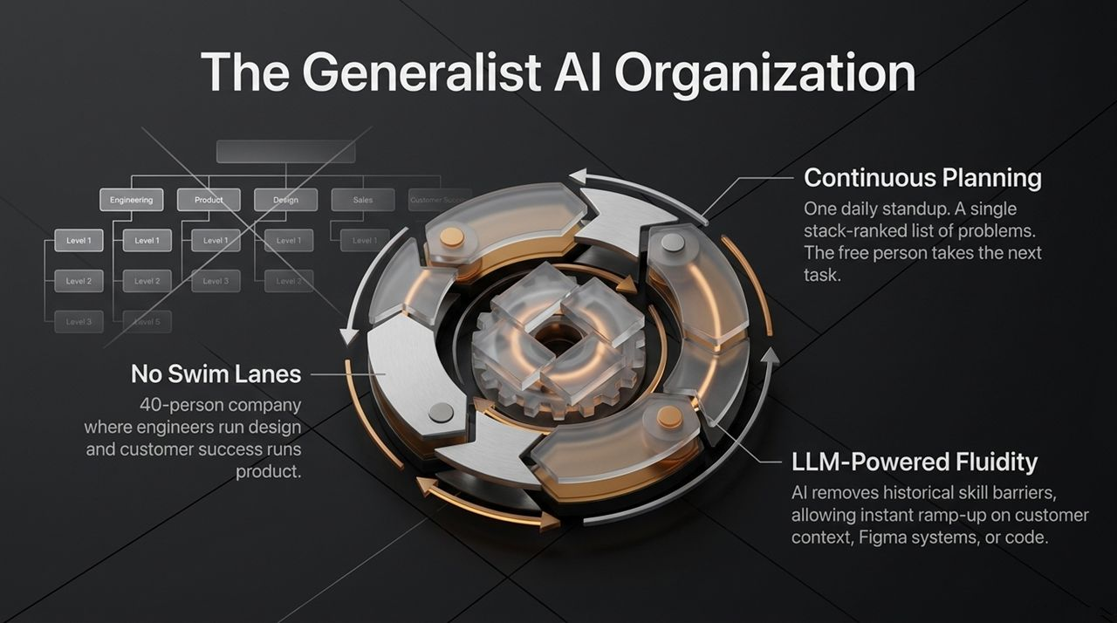
Notes:
Building AI-native products requires an AI-native company structure. Traditional SaaS companies build rigid department silos.
Lightfield operates with a 40-person generalist organization:
No Swim Lanes: Everyone participates in product design and customer success.
Continuous Planning: The entire company attends a single daily standup. A single, prioritized issue list dictates execution; available team members take the next top task regardless of title.
LLM Fluidity: Generative AI tools allow engineers to modify Figma design files and CS team members to write code or run queries, breaking operational barriers.

Slide 13
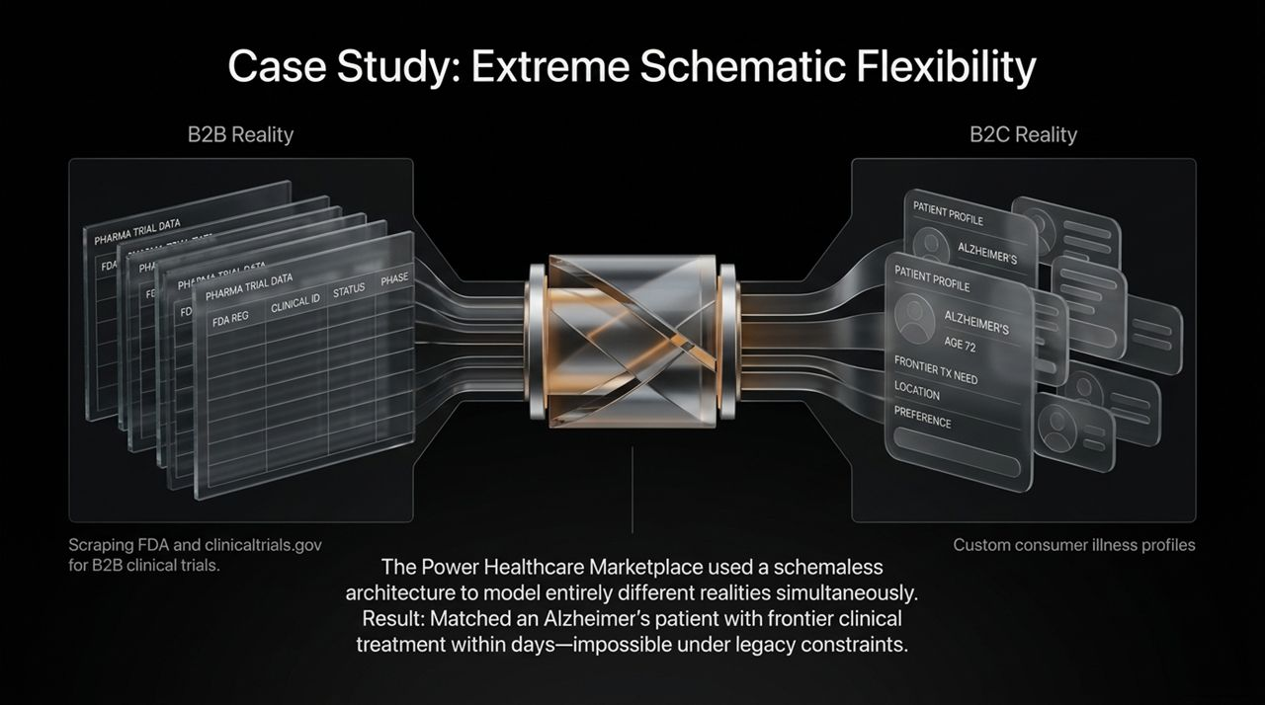
Notes:
To see schematic flexibility in action, consider Power, a healthcare marketplace customer.
Power needed to connect two vastly different data environments: complex B2B clinical trial parameters scraped from the FDA, and highly custom B2C patient health profiles. Traditional relational CRMs cannot handle both without complex custom engineering.
Using Lightfield’s schemaless World Model, Power mapped clinical trial parameters directly against unstructured patient profiles. The result: Lightfield successfully matched an Alzheimer’s patient with a frontier clinical trial within days—a outcome that would be nearly impossible under traditional database constraints.

Slide 14
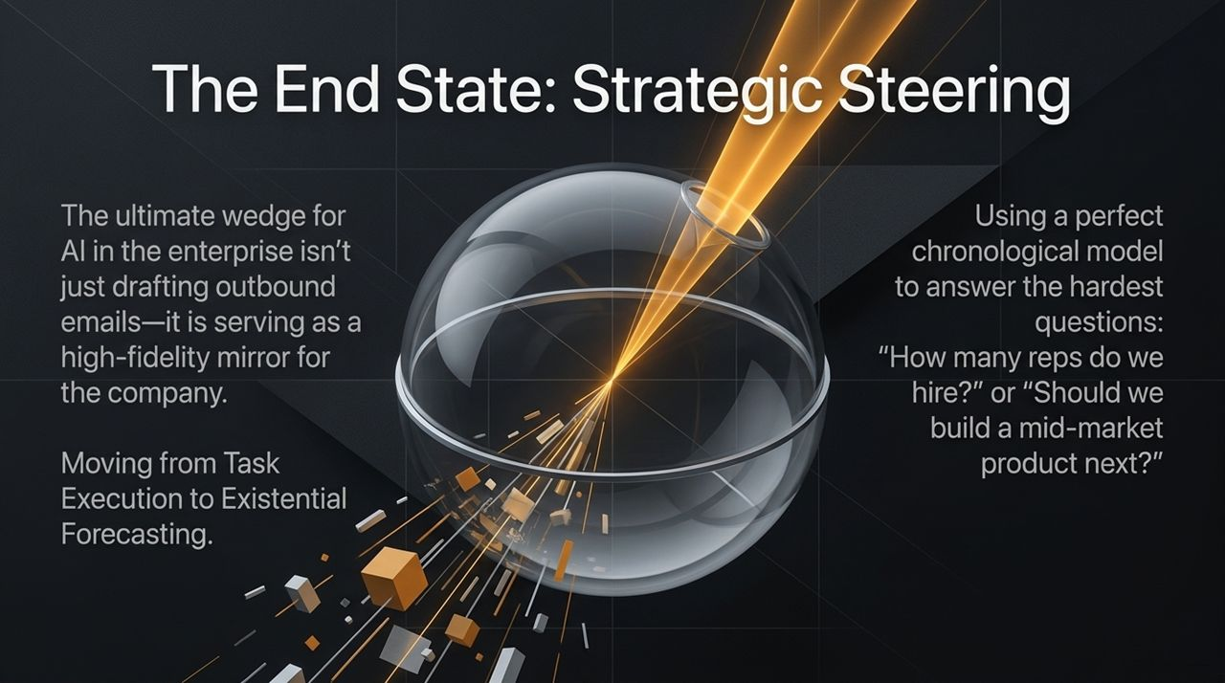
Notes:
The endgame for AI in the enterprise isn't just drafting outbound sales emails. The true value lies in Strategic Steering.
Because Lightfield maintains an accurate, chronological record of all internal and external activity, executives can use it as a 'crystal ball' for scenario planning. Leaders can ask complex strategic questions like:
'Based on current mid-market deal velocity, when should we hire 10 more reps?'
'Should we build a specialized mid-market tier next?'
Lightfield transforms the CRM from a passive database into a core strategic engine.

Slide 15
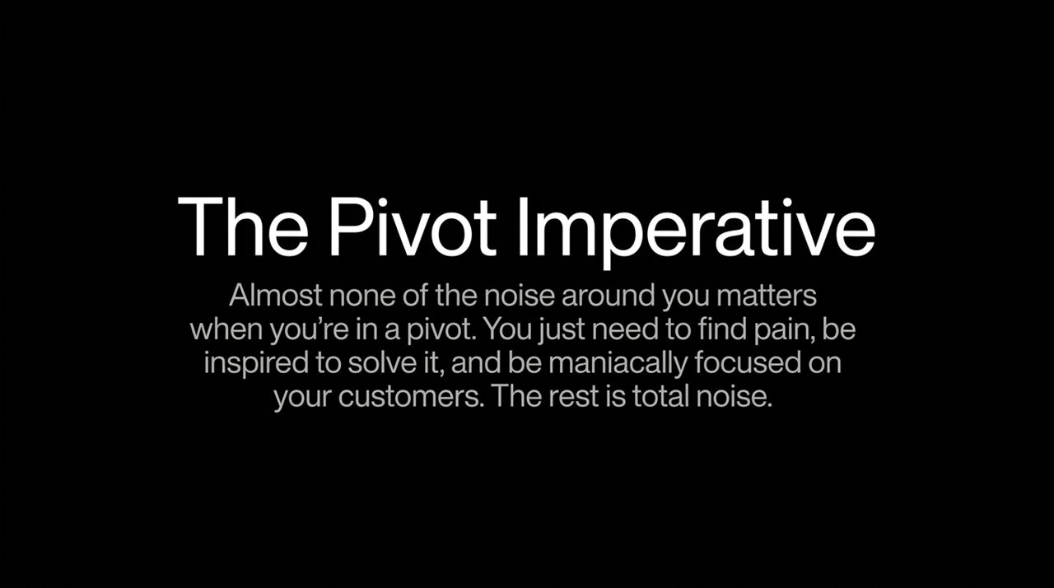
Notes:
Slide 15 captures Keith Peiris’s primary lesson on execution:
'Almost none of the noise around you matters when you're in a pivot. You just need to find pain, be inspired to solve it, and be maniacally focused on your customers. The rest is total noise.’
During major pivots, founders are flooded with opinions about valuation drops, office optics, and market trends. Lightfield’s success demonstrates that tuning out external chatter and focusing relentlessly on customer problems is the key to building enduring companies.

Slide 16
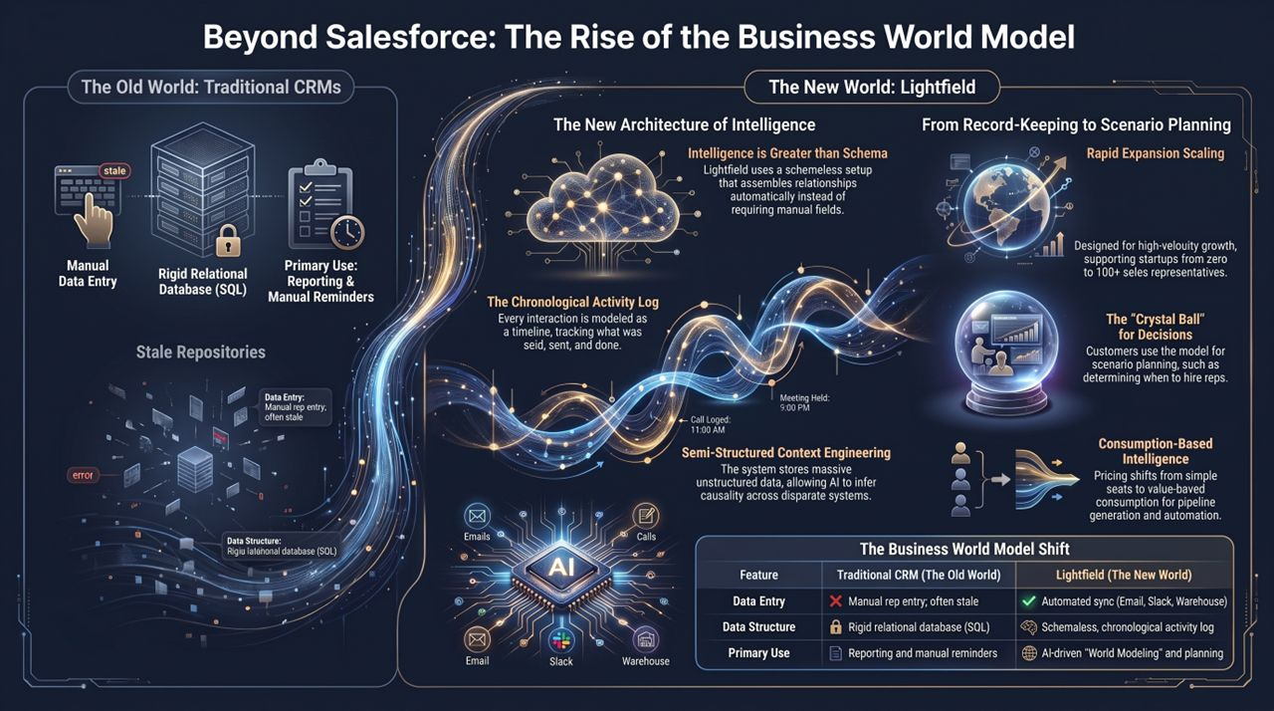
Notes:
To wrap up today’s presentation, let’s summarize the structural paradigm shift:
Data Entry: Traditional CRMs rely on manual rep entry that quickly becomes stale. Lightfield features automated sync across Email, Slack, and Data Warehouses.
Data Structure: Relational SQL tables give way to a schemaless, Chronological Activity Log.
Primary Use: Static reporting and manual task reminders transition into AI-driven world modeling and strategic scenario forecasting.
Business Model: Pure seat pricing evolves into hybrid platform fees combined with value-aligned consumption pricing.
Lightfield demonstrates that the next generation of enterprise software will not look like Salesforce—it will function as a real-time, intelligent mirror of the business. Thank you.
https://www.youtube.com/watch?v=K5yGLO8c6T0

